Slide 1


Team 15: Rogue Chess App Status Update 5 Jose Herrera, Travis Head Sponsor: Pranav Dhulipala TA: Eric Robles
Notes:
Michelle

Slide 2
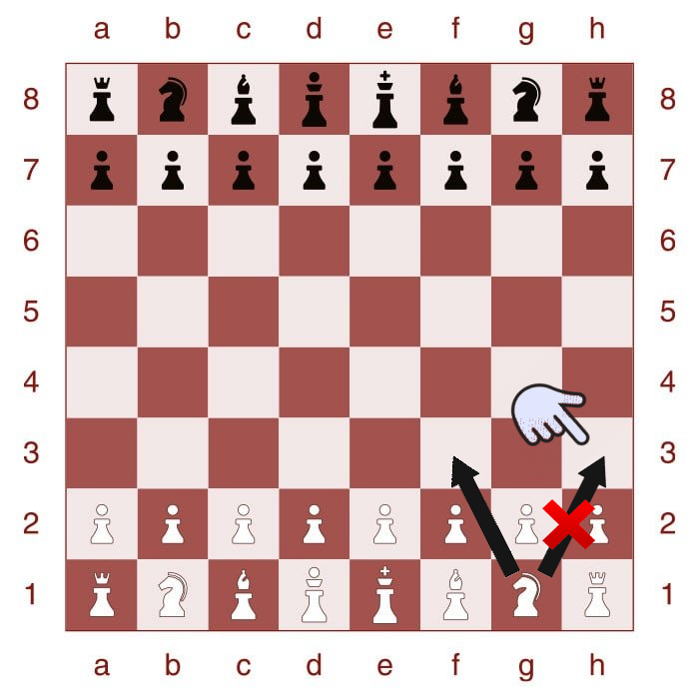
Project Summary
Problem: There are many variations of the game of chess; however, after a while it can be predictable or lack of excitement.
Proposed Solution: Develop an app of a new chess variation with a randomization factor for Android products.
Develop an AI for Single Player Mode
Create a randomization factor
Create a User Interface for the players interaction
Highlighted boxes to assist the player in making the next move legally
Create different difficulty levels
Upload the contents to the cloud
Notes:
Kyle

Slide 3
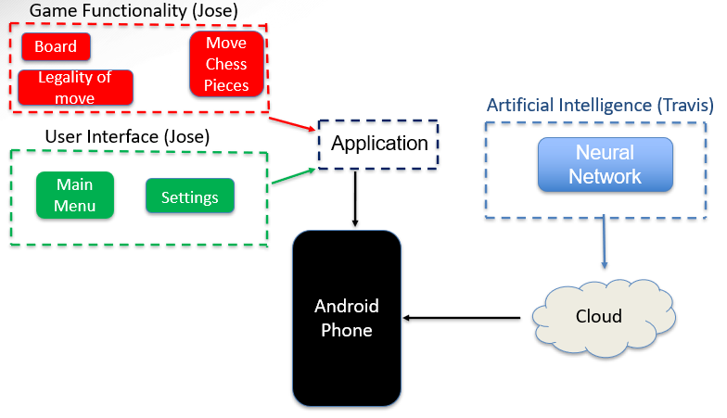
Project Overview
Notes:
Eric

Slide 4
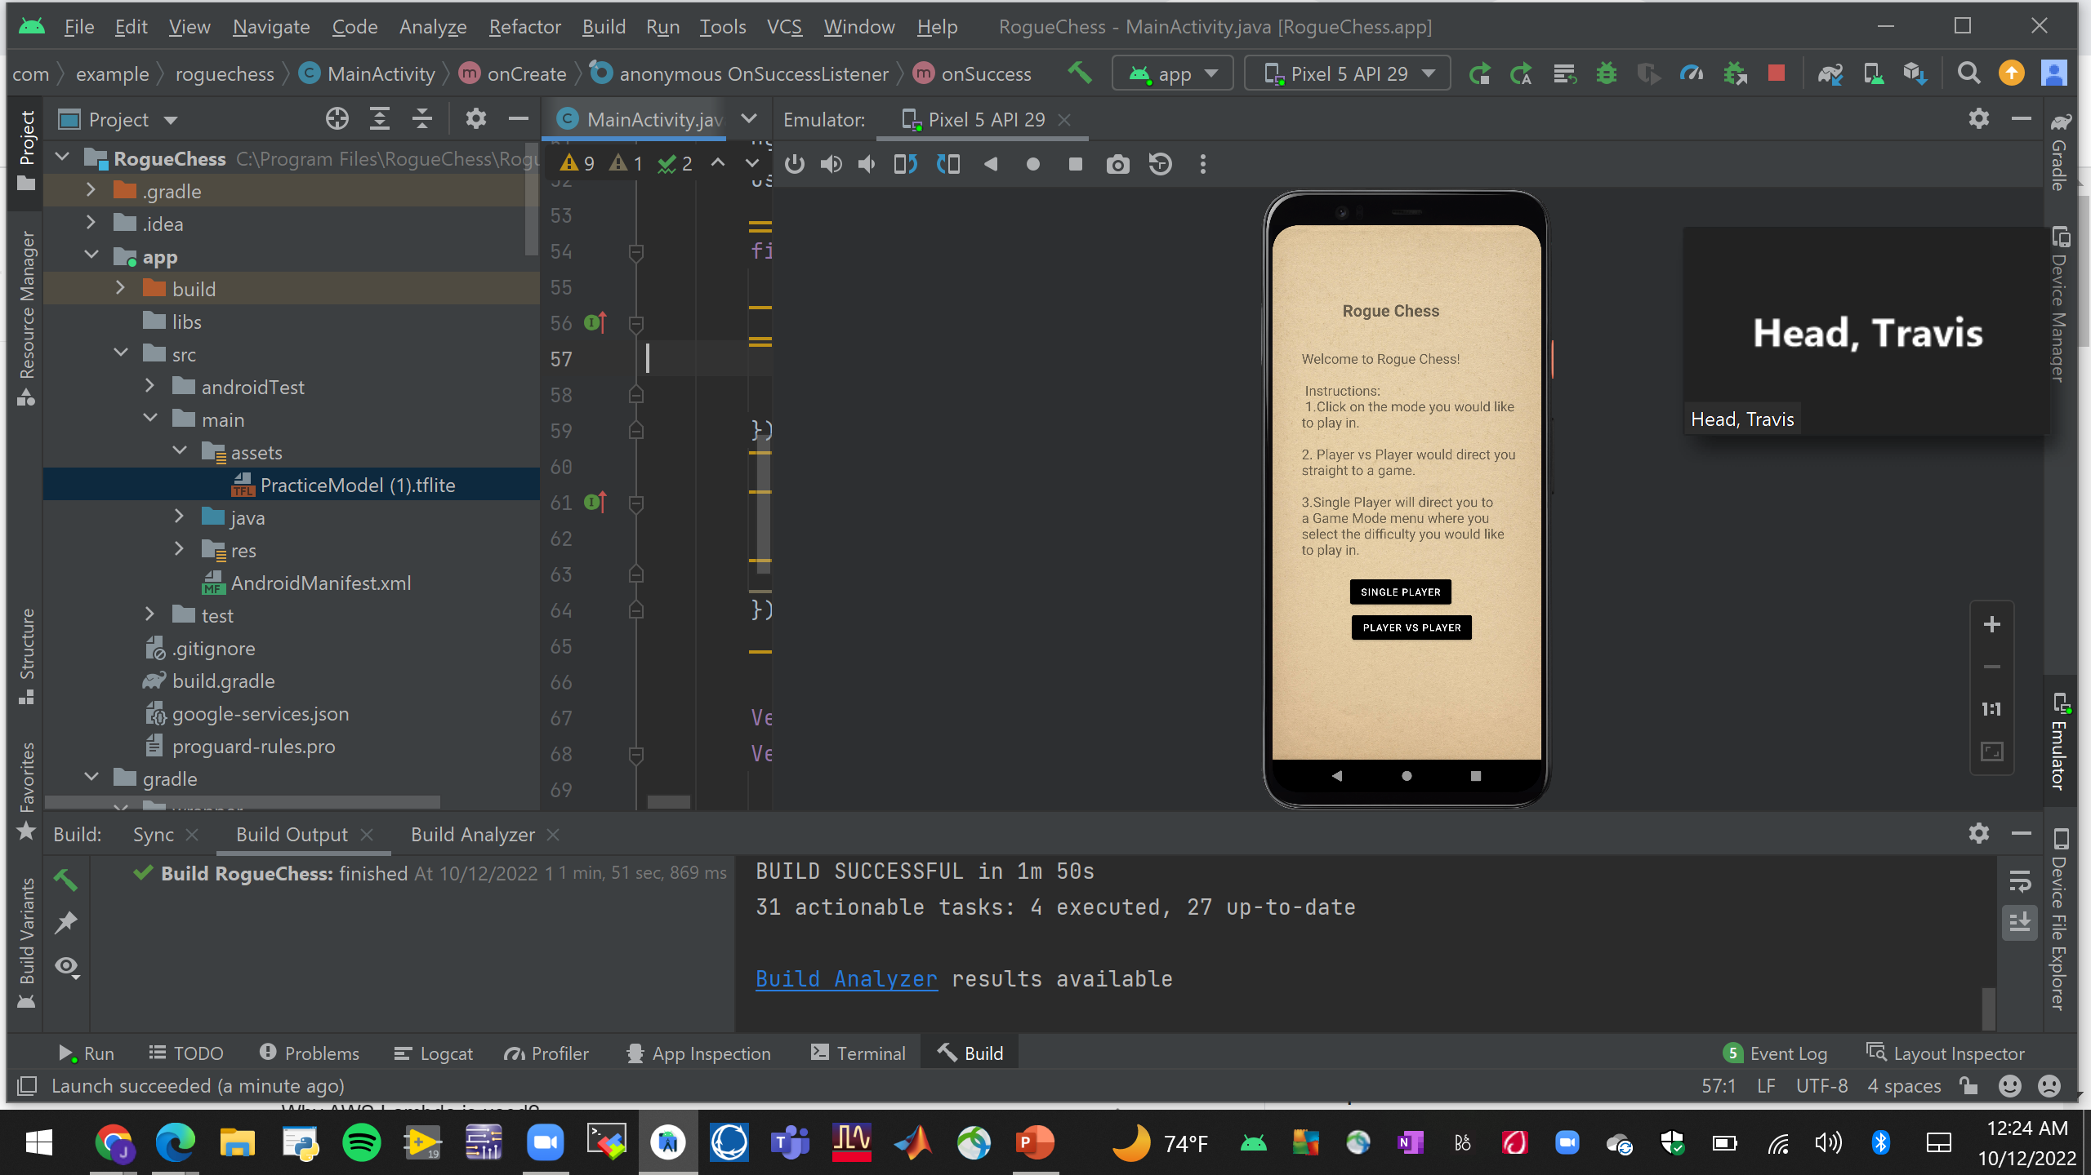
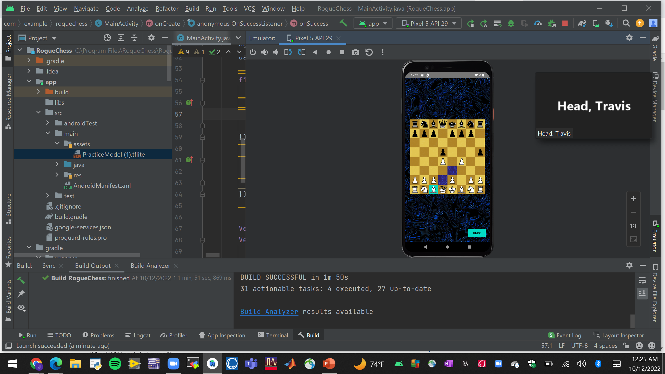
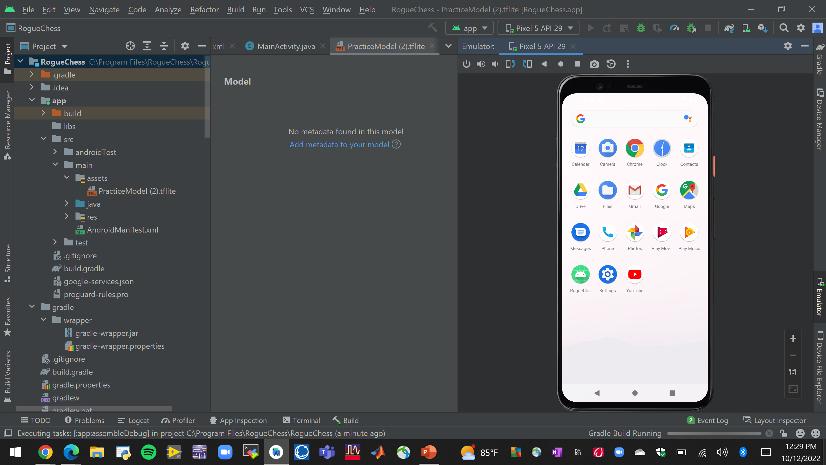
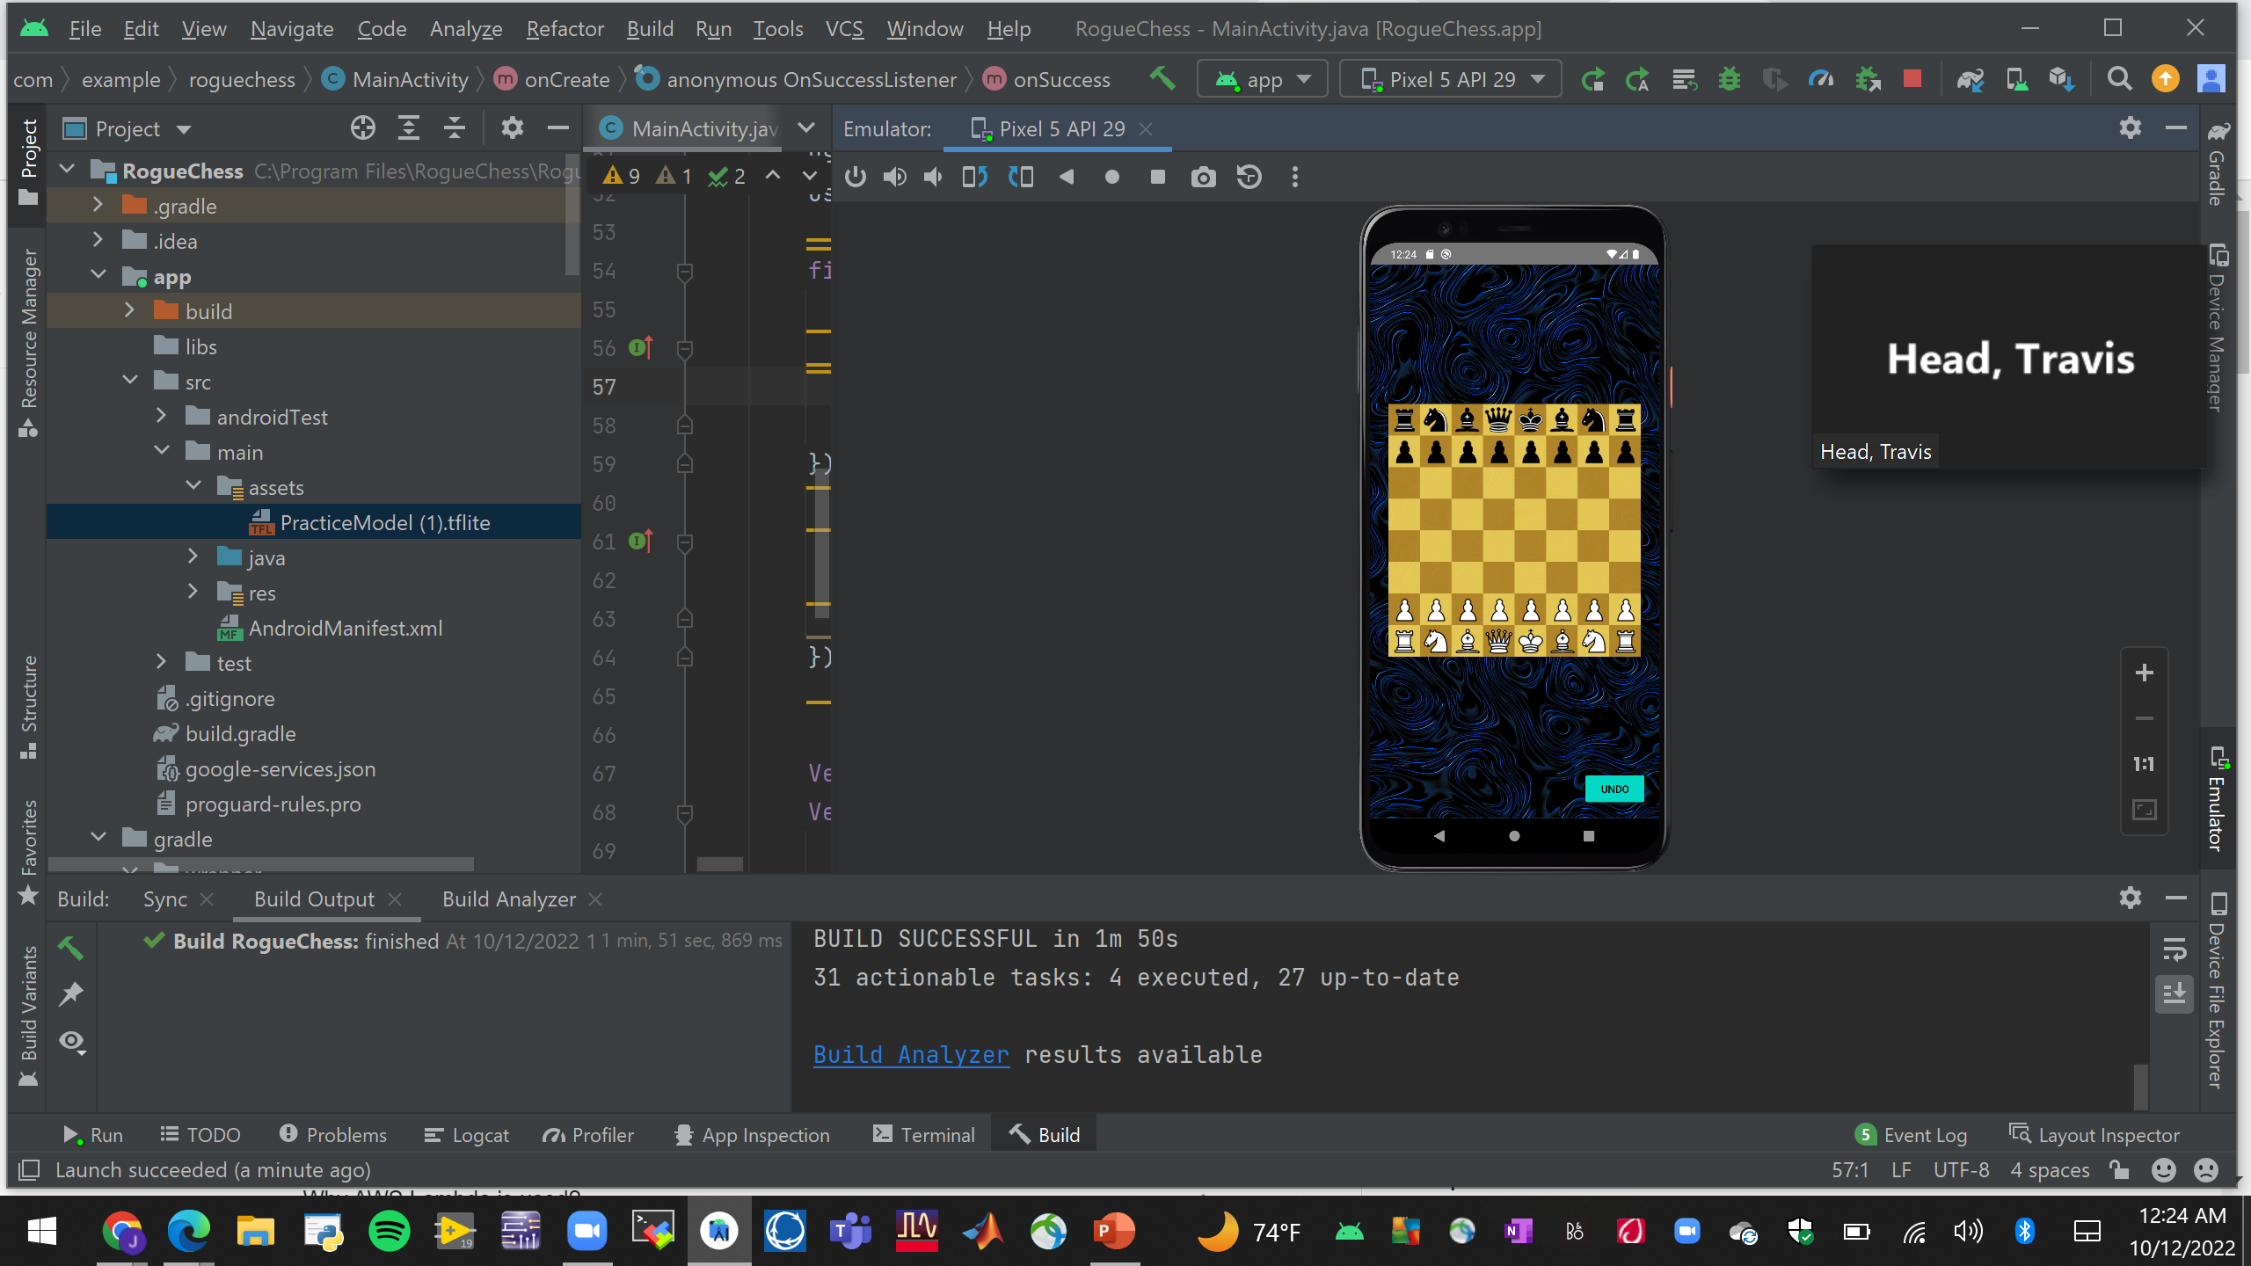
Integrated System Diagram
Select Game Mode
AI or second player move
App is installed
Open App
Player Makes move
When Game Over
Notes:
Eric

Slide 5
Project Timeline
Subsystem Corrections (to complete by 9/19) | Research for Server Integration (completed 9/12) | Connection of Game App to Server (to complete by 9/20) | Connection of AI & App to Server (to complete by 9/26) | Final Integration (to complete by 10/17) | Validation (to complete by 11/16) | Demo and Report (to complete by 11/28)
__ - Completed
__ - In Progress
- Not Started
Notes:
Eric

Slide 6
Team Integration Progress
Jose Herrera and Travis Head
Accomplishments since last presentation 30 hrs of effort | Ongoing progress/problems and plans until the next presentation
Created Files for A.I. installation App data outputs for piece movement Difficulty data outputs for game mode Piece placement and piece type outputs as matrix | Finalize integration with A.I. to call movements and visualize in app

Slide 7
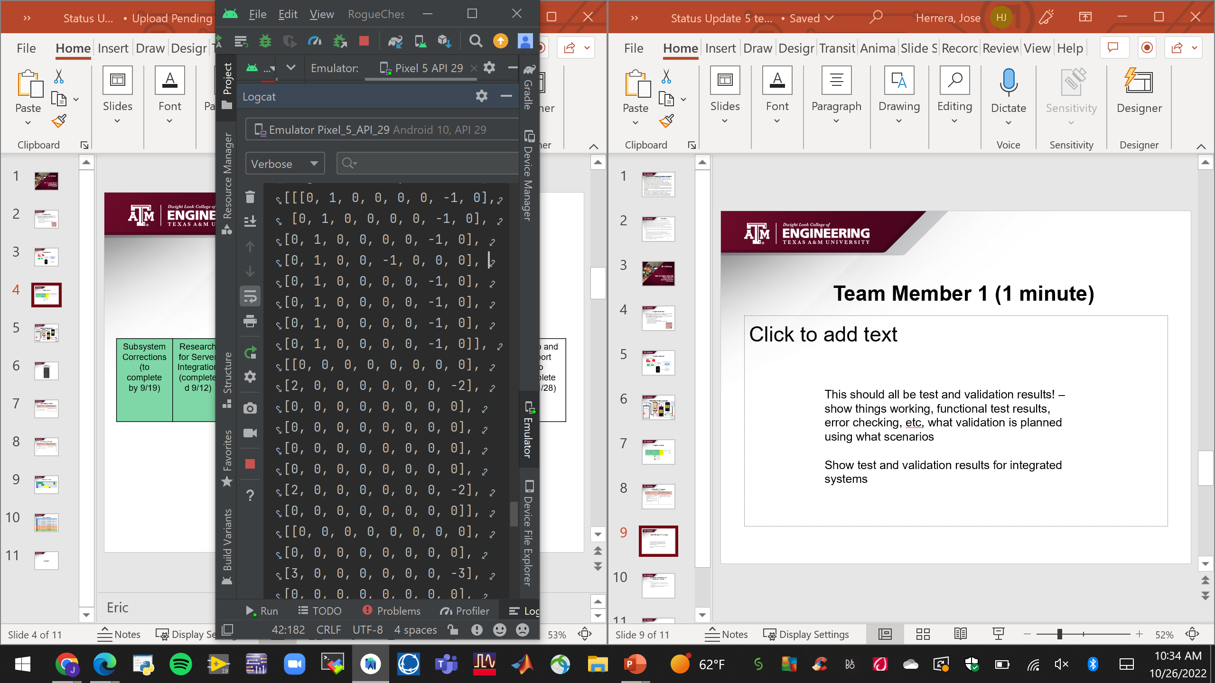
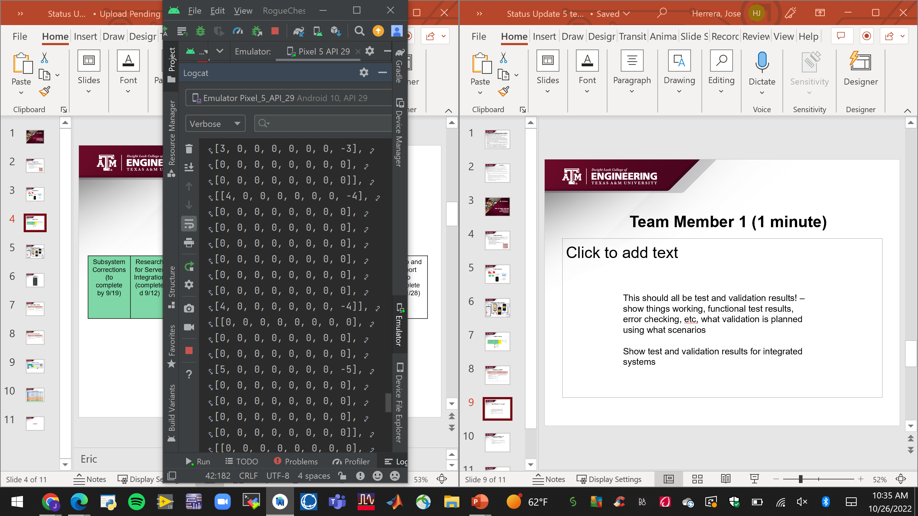



Team Integration
White Piece Movement
Black Piece Movement
Key:
-1: White Pawn 1: Black Pawn
-2: White Knight 2: Black Knight
-3: White Bishop 3: Black Bishop
-4: White Rook 4: Black Rook
-5: White Queen 5: Black Queen
-6: White King 6: Black King

Slide 8
Reviews

Slide 9
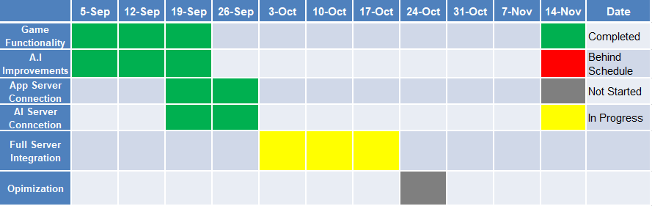
Execution Timeline
Notes:
Michelle

Slide 10
Execution & Validation Plan
Execution plan
Your team planned milestones for completion of any remaining integration, test, and validation plans should be presented.
Milestones should have owners … system tests, and full system integration can be group owned
Gantt chart.
Notes:
Michelle

Slide 11
Thank you!

